Slide 1
Section 1

Slide 2
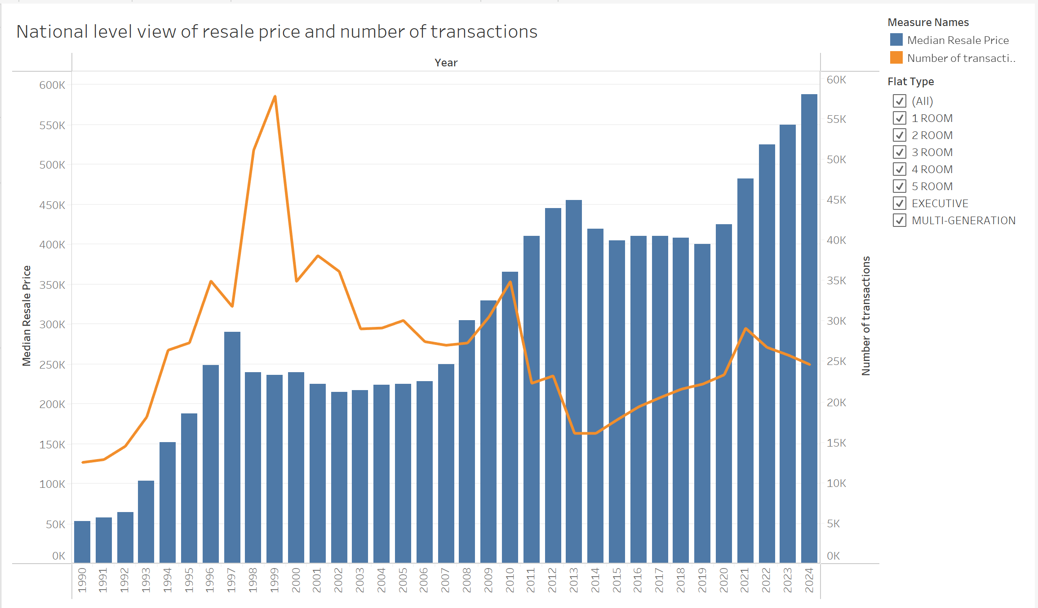
Overview of transactions over the years

Slide 3
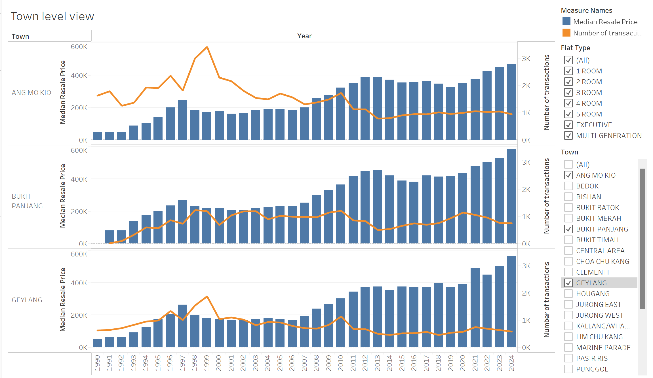
Town level view

Slide 4
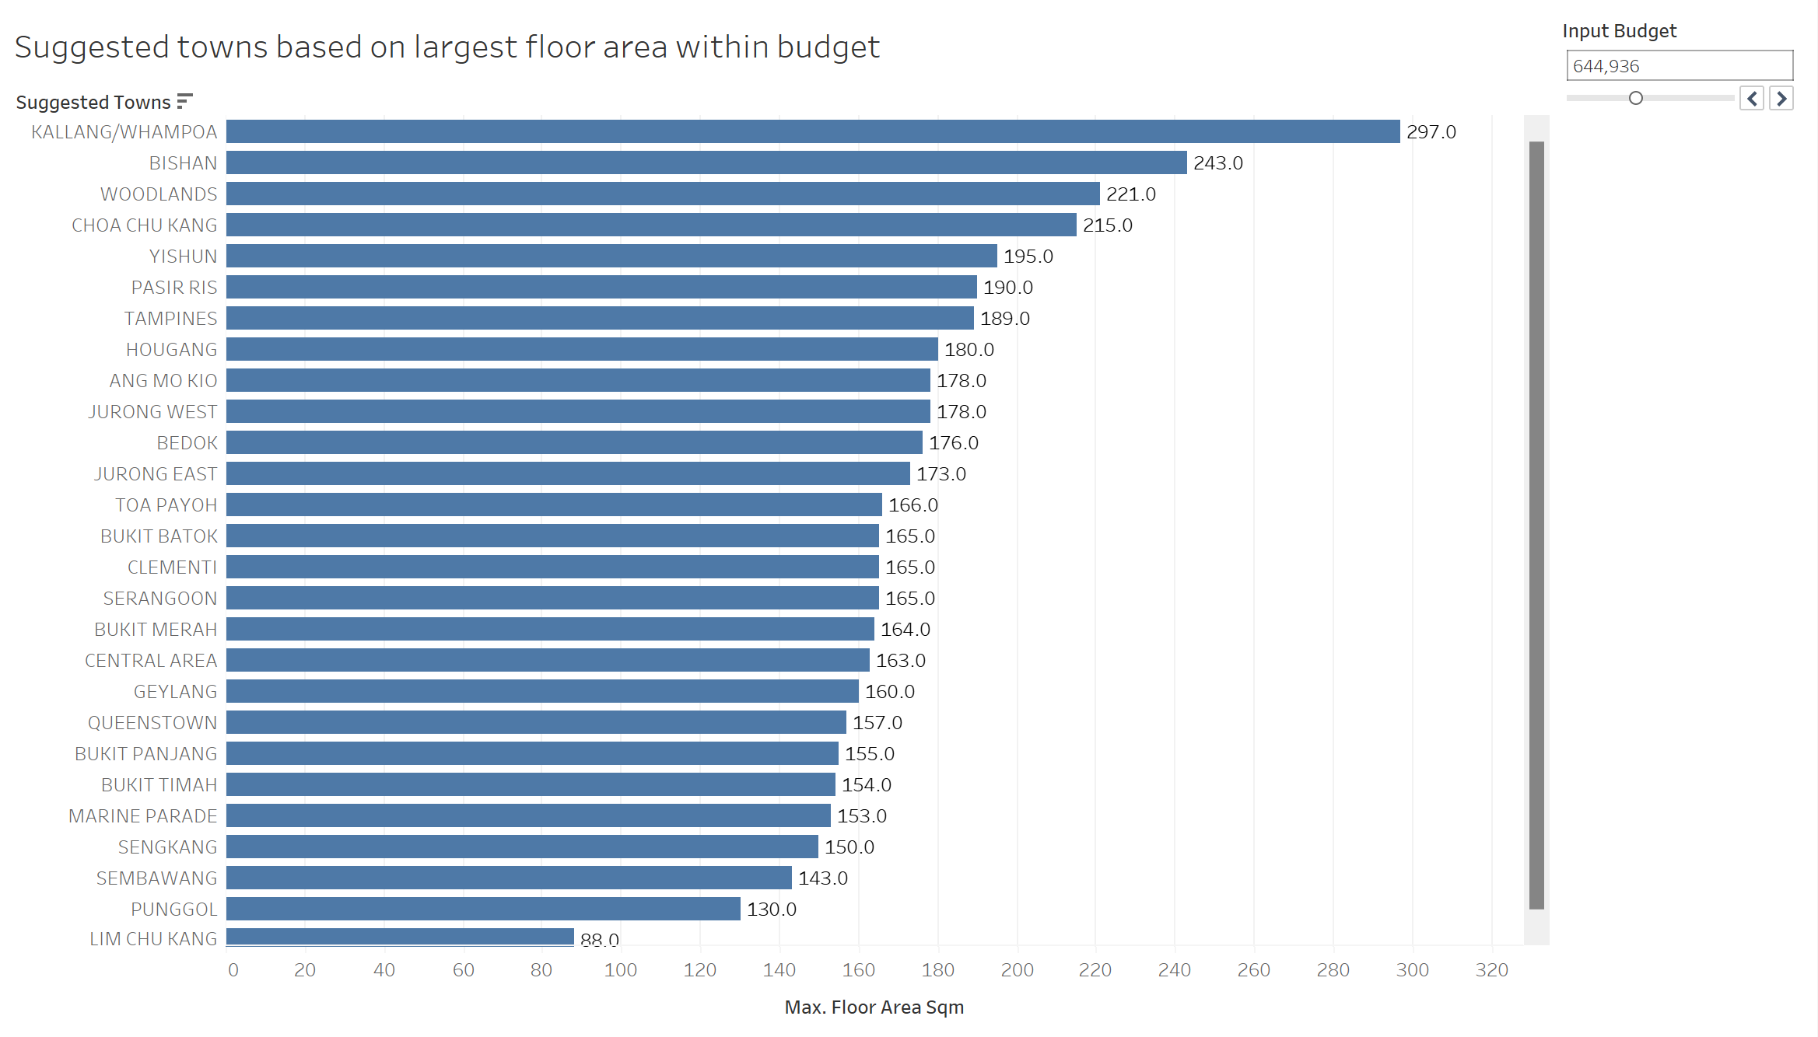
Suggested towns with largest floor area within budget
Based on the example input budget, Kallang/Whompoa offers the largest floor area within the budget.

Slide 5
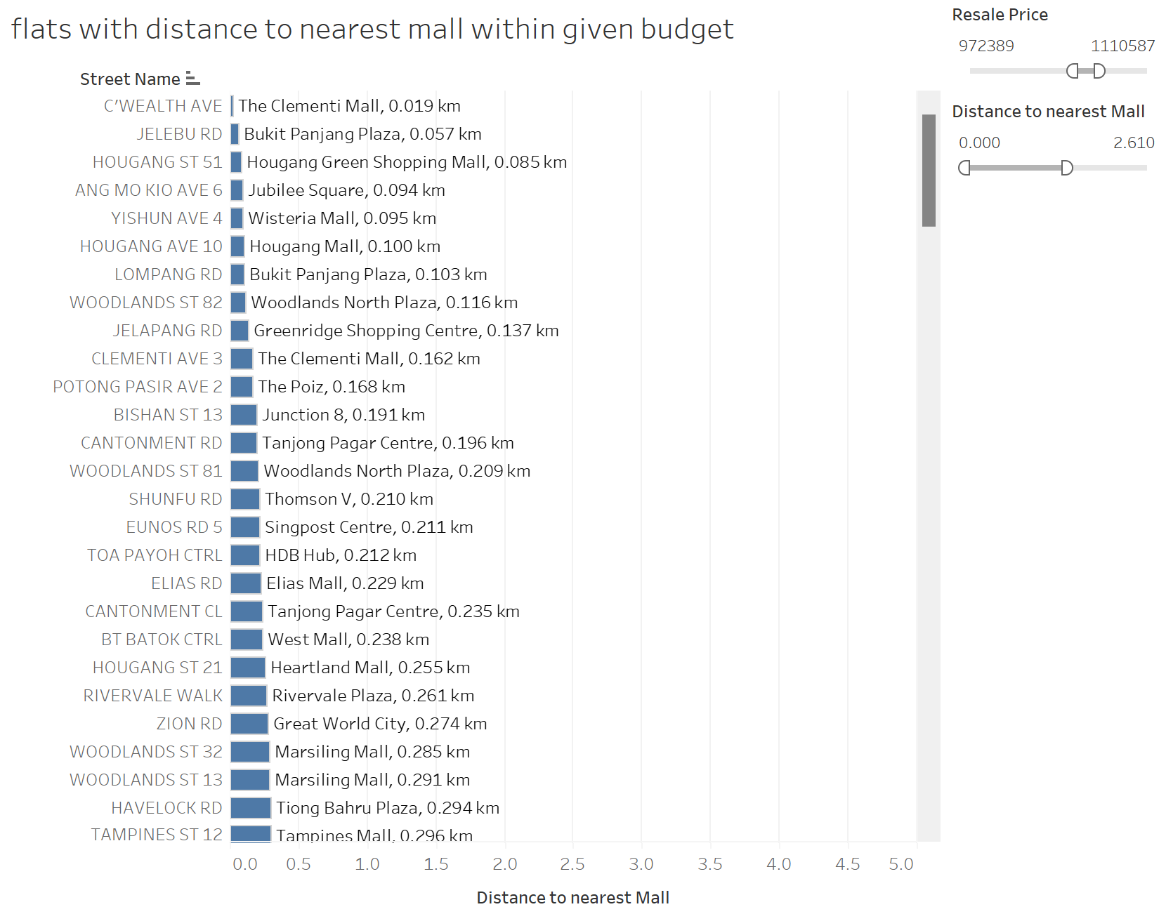
Selecting flats based on nearest amenity (malls):
Dashboard allows user to input their budget optimise flat selection based on distance to nearest mall

Slide 6
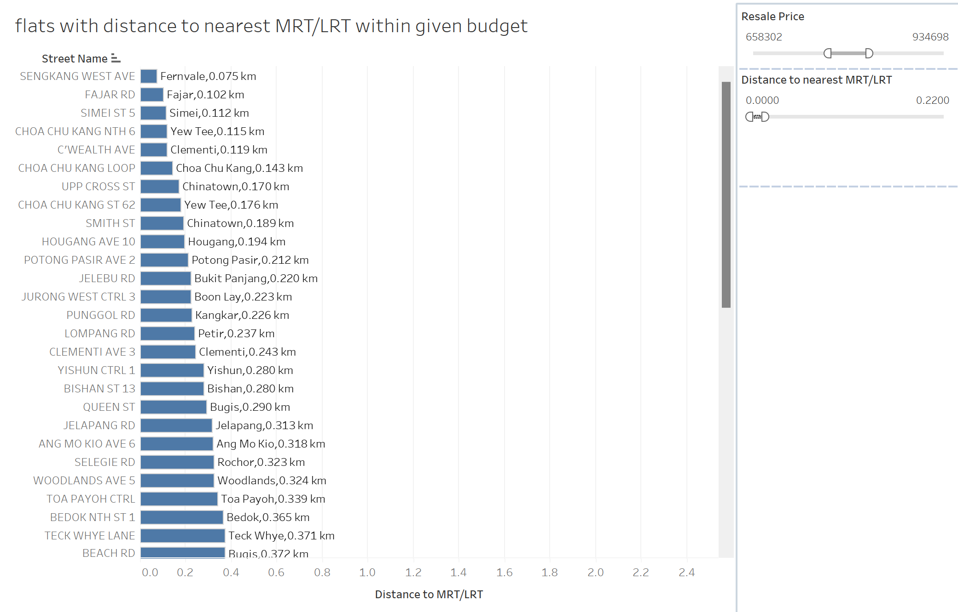
Selecting flats based on nearest amenity (mrt):
Dashboard allows user to input their budget optimise flat selection based on distance to nearest mrt

Slide 7
Section 2

Slide 8
Question A
Predict a resale flat price’s transaction price in 2014. Use the following characteristics: flat type, flat age and town. Propose and implement a minimum of three models, select the best model, and explain the reasons for your choice.

Slide 9
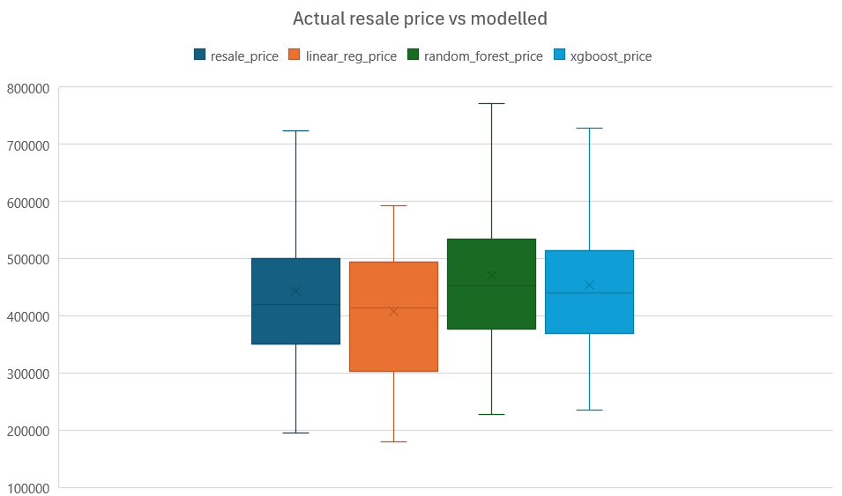
Comparison between models
The 3 models used were linear regression, random forest and XGBoost. The model is trained on all data except for 2014 and tested against 2014 actual data.
Below are the key metrics of each model:
Mean Squared Error (x10⁹):
Linear Regression: ~8.39
Random Forest: ~3.44
XGBoost: ~2.97
Mean Absolute Error:
Linear Regression: 62000
Random Forest: 44000
XGBoost: 41000
R squared:
Linear Regression: 0.445
Random Forest: 0.772
XGBoost: 0.80
Based on their key metrics and from the visual plot, XGBoost provides the best prediction.
Script: question_A.py

Slide 10
Question B
A flat was sold in Nov 2017 with the following characteristics:
…
Was this(550,800) a reasonable price for the transaction? How confident are you in your assessment?

Slide 11
Determining price reasonability
The question introduces 3 new features that were not implemented in our previous model:
Flat model
Storey Range
Floor Area
From the previous question, XGBoost is determined to be the best model. Implementing these features in our model and doing a 2:8 train/test split, below are the key metrics of our model:
Mean Squared Error (x10⁹): 1.63
Mean Absolute Error: 27.4k
R squared: 0.946
Script: question_B.py

Slide 12
Sales price of $550,800 is reasonable
The new model predicted a price of 579,438.06 as compared to the actual sales price of 550,800. (difference: 5.1%)
The xgboost model predicted sale prices with a Mean Absolute error(MAE) of 27k and R-squared of 0.946. The MAE indicates that the model’s predictions deviate from the actual prices by approximately 27k on average. An R-squared value of 0.946 suggests that 94.6% of the variance in the resale prices is explained by the model, demonstrating its reliability.
As the actual sales price is close to MAE range from the predicted price, the transaction is reasonable. I have high confidence in my assessment due to the low MAE value as compared to the resale price, and a R-squared value of close to 1.
Script: question_B.py

Slide 13
Question C
Someone mistakenly deleted the column containing data on Flat Type in the database. While backups exist, these data are critical to HDB’s daily operations, and time would be needed to restore these data from the backup.
Senior management would like you to create a model to predict flat type given a transaction’s other characteristics. Explain the reasons for choosing this model.

Slide 14
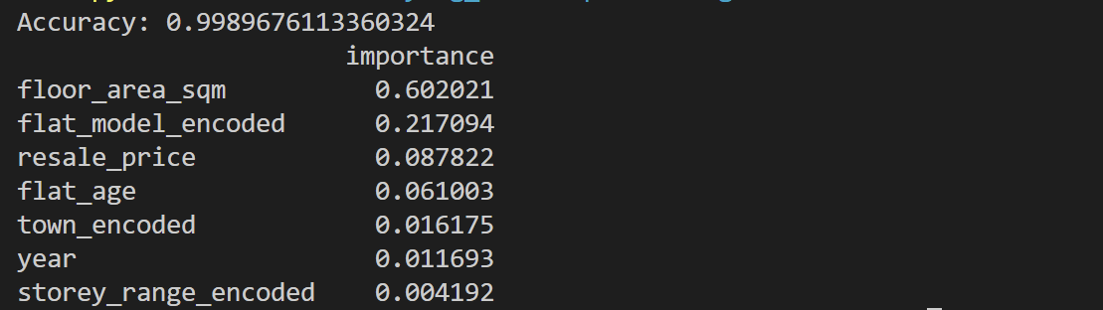
Creating a model to predict the flat type
The model was created using past 10 years (2014-2024) data for training. The model chosen is the Random Forest Classifier, due to the categorial and non-ordinal nature of flat types. The model was able to predict the category of flat types with a 99.9% accuracy, using the features shown below. The order of importance of each features are also listed below.
Script: question_C.py

Slide 15
Section 3

Slide 16
Question A
Yishun has received a negative reputation as “Crazy Town”, and property prices might have been impacted.
Are Yishun flats the cheapest in the country?

Slide 17
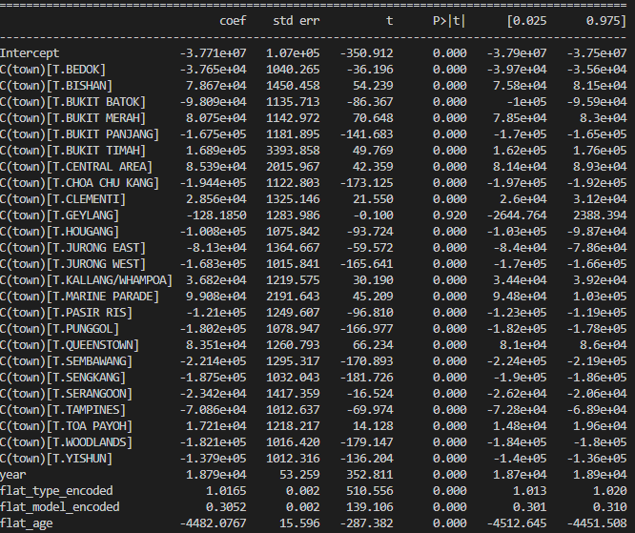
Yishun prices are not the cheapest in the country
Using a linear regression model, the coefficients of each town is listed, along with other important features determined through a correlation matrix.
Interpretation
The coefficient of Yishun is -137900, meaning it is $137900 cheaper than the reference town. Since this value is not the lowest (Woodlands, Tampines are lower) , it can be said that Yishun flats are not the cheapest with all other features considered.
Script: question_A.py

Slide 18
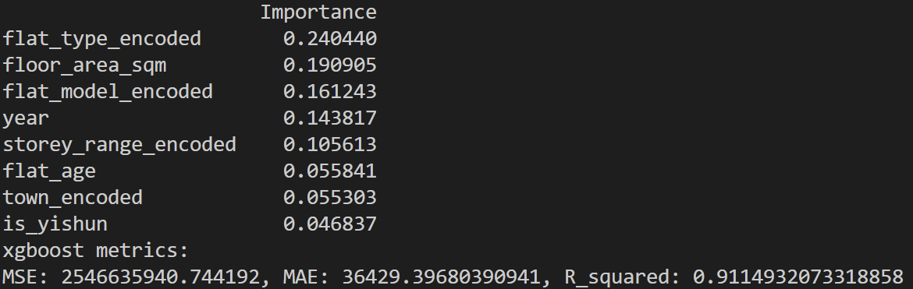
Yishun prices are not impacted by its reputation
To further check whether the flat is in Yishun will impact the resale price, the previous XGBoost model was retrained from 2014 onwards with an additional “is_yishun” parameter. The importance of each feature in relation to the target variable(resale price), as well as how accurate our model is listed below:
Is_yishun is ranked last in importance with less than 5% importance. Therefore, whether the flat is in Yishun has little influence on the resale price.
Script: question_A.py

Slide 19
Question B
Some members of public have been saying that flat sizes have gotten smaller over the years.
Is there any truth in this statement?

Slide 20
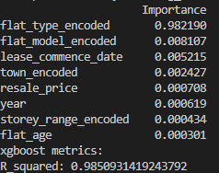
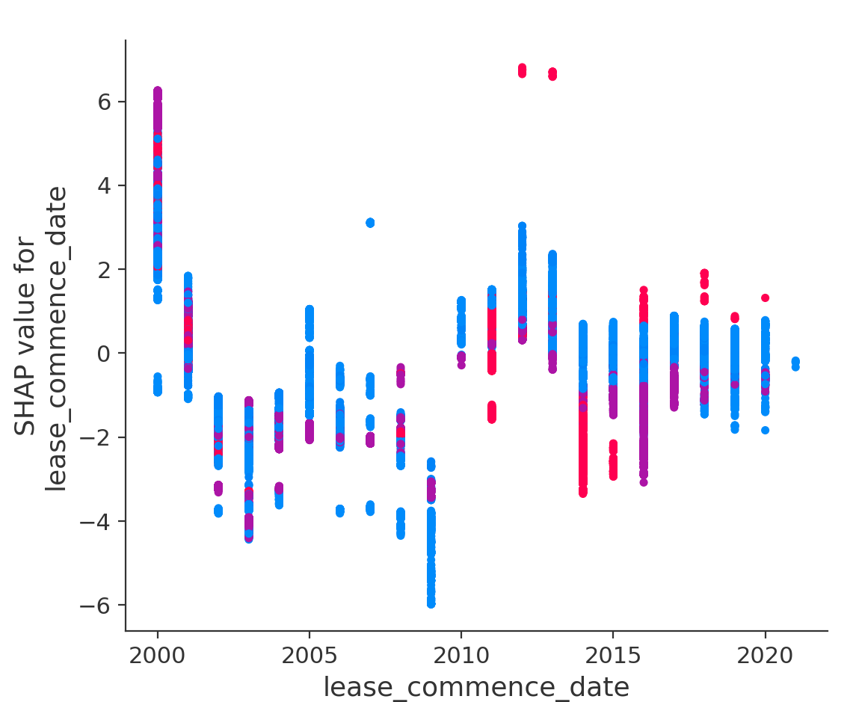
Flat sizes did not become smaller over the years
The model used is XGBoost to determine if lease commence date affects floor area since 2000. Below are the key observations:
Feature importance:
SHAP value:
The model predicts with a high accuracy that the floor area is not affected (<1% importance) by the lease commence date. The major deciding factor is the flat type.
Furthermore, the SHAP value for lease commence date is not too skewed to positive/negative values, meaning that the commencement dates does not conclusively impact floor area positively or negatively.
Script: question_B.py

Slide 21
Question C
The Downtown Line Stage 2 connects the Bukit Panjang heartland to the city.
Have prices increased for resale flats in the towns served by this Line? You might want to use a differencein-differences model for this task.

Slide 22
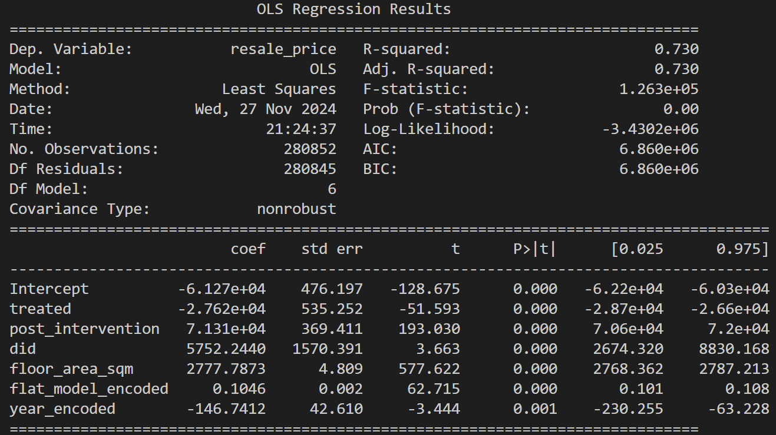
DTL2 opening had limited impact on resale prices
The announcement of DTL2 was made on 2007 July. Timeframe used for pre-treatment is 2000 - end 2007, post treatment is 2008-2009 to measure the immediate effect of the announcement. Other important features were included in the formula.
Formula = "resale_price ~ treated + post_intervention + DiD + floor_area_sqm + flat_model_encoded + year"
Interpretation
treated = -27620 : Towns near DTL2 are cheaper than non- treated towns (baseline difference)
post intervention = 71310: Resale prices increased by 71310 on average between pre-intervention(2000-2007) and post intervention (2008-2009).
DiD = 5752: After DTL2 was announced, nearby towns experienced on average an additional $5752 increase in resale prices compared to other towns.
Total increase in price: 71310 + 5752 = ~$77000
Script: question_C.py

Slide 23
Question D
There have been comments online that people are buying flats in towns further from the city so that the cost savings can be used for a car.
Are resale prices in HDB estates in areas further away from the city (i.e. Sengkang and Punggol) impacted by Certificate of Entitlement (COE) prices for cars?

Slide 24
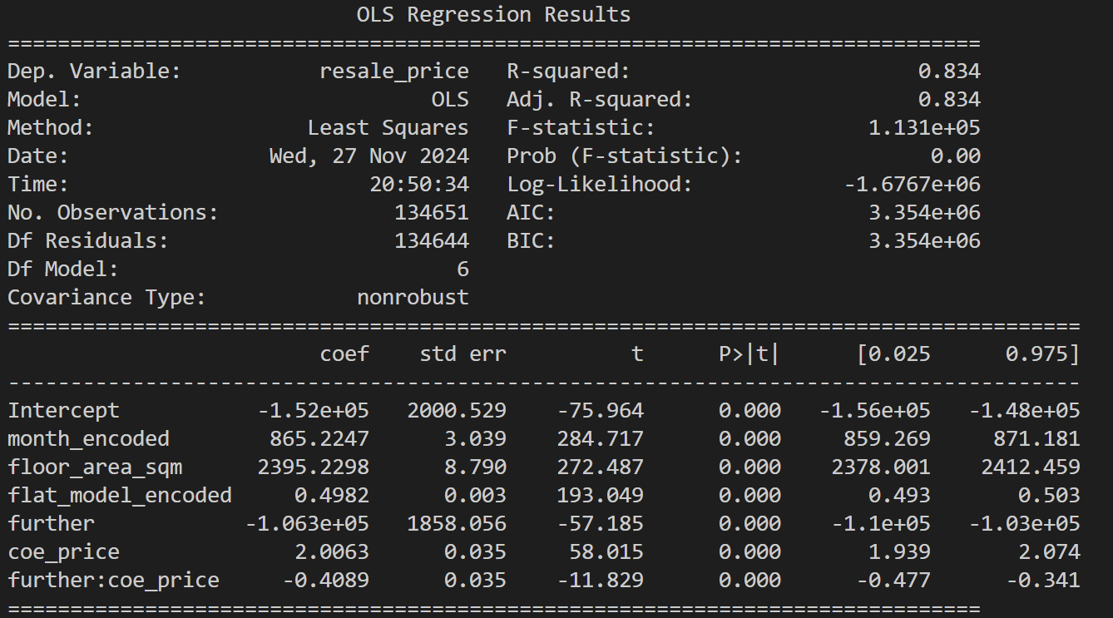
Resale prices in further towns are more impacted by COE prices
The model used is a multiple linear regression model with an interaction term between COE prices and distance to city (near/far). A high interaction term coefficient means that the resale prices of flats further away from the city are impacted more by changes in COE prices, compared to flats nearer to the city.
Interpretation of result:
Coefficient of coe_premium = 2 : For every dollar increase in COE premium, resale prices increase by $2 on average, possibly due to other external factors. (baseline increase)
coefficient of interaction term = -0.4 : For every for every dollar increase in COE, further towns are cheaper by $0.4.
Putting it all together, if COE prices increase by $1000, resale flat prices across singapore would see an average increase of $2000. However, towns further from the city would additionally see a price decrease of $400.
One interpretation could be as COE prices of cars go up, people might not be as tempted to buy flats further away from the city, resulting in lower demand.
Script: question_D.py

